Slide 1
Mobile Line Check

Slide 2
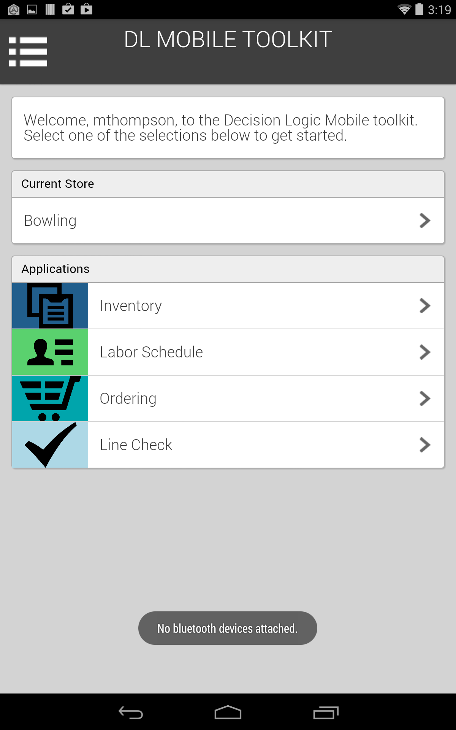
Select the menu button in the top left hand corner to drop down the menu.

Slide 3
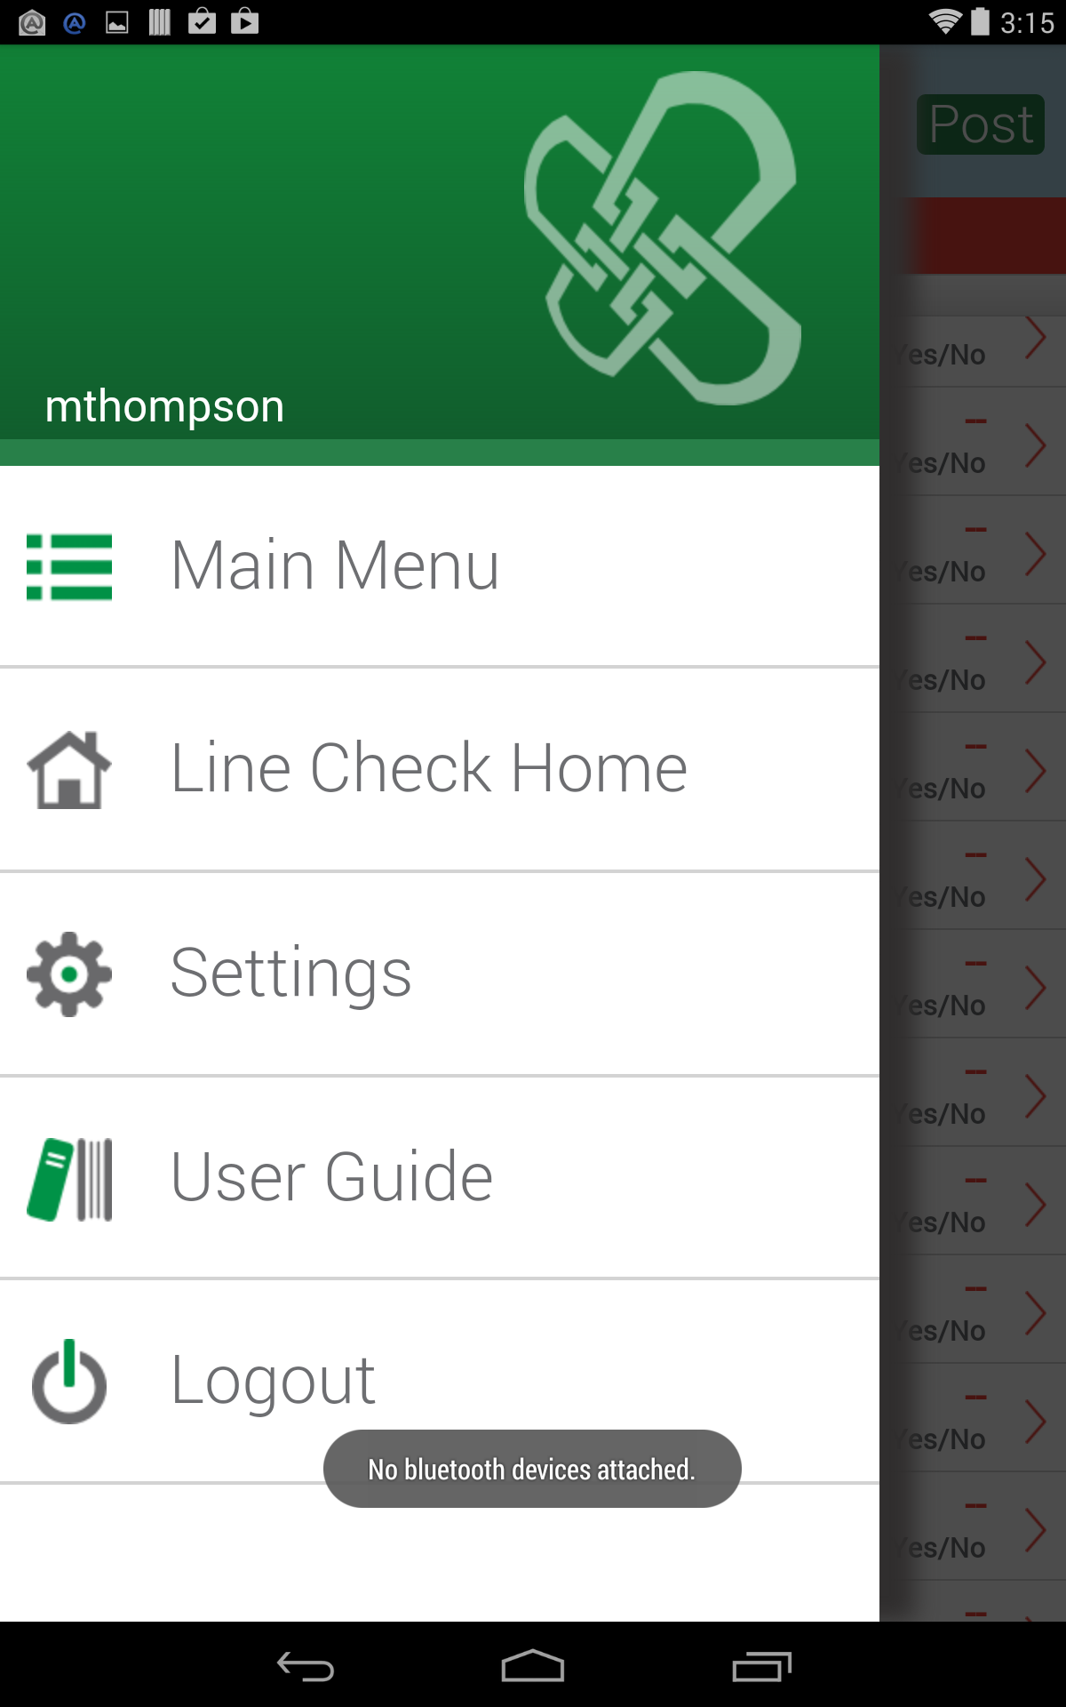
Select Main Menu to move back to the home screen

Slide 5
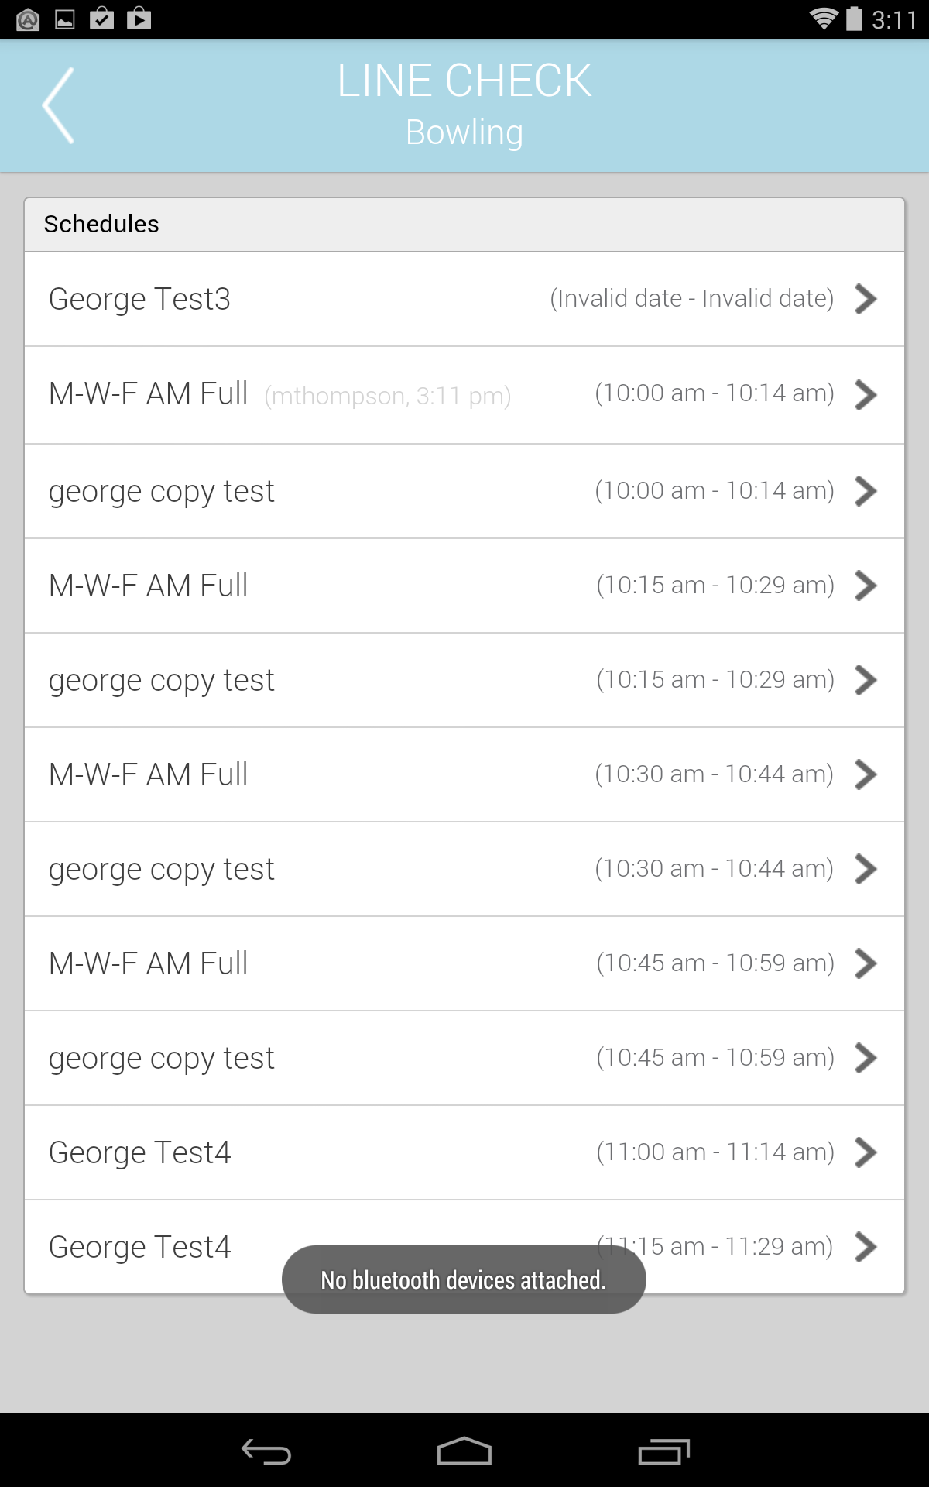
Select Line Check

Slide 6
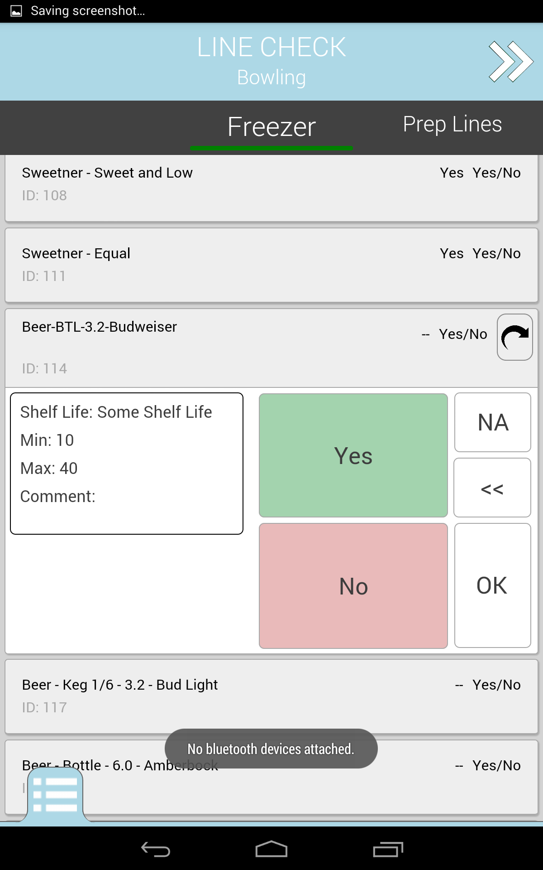
Select an item to enter a value.
Enter a value and select OK to move on to the next item.
NA will mark the product as currently not available

Slide 7
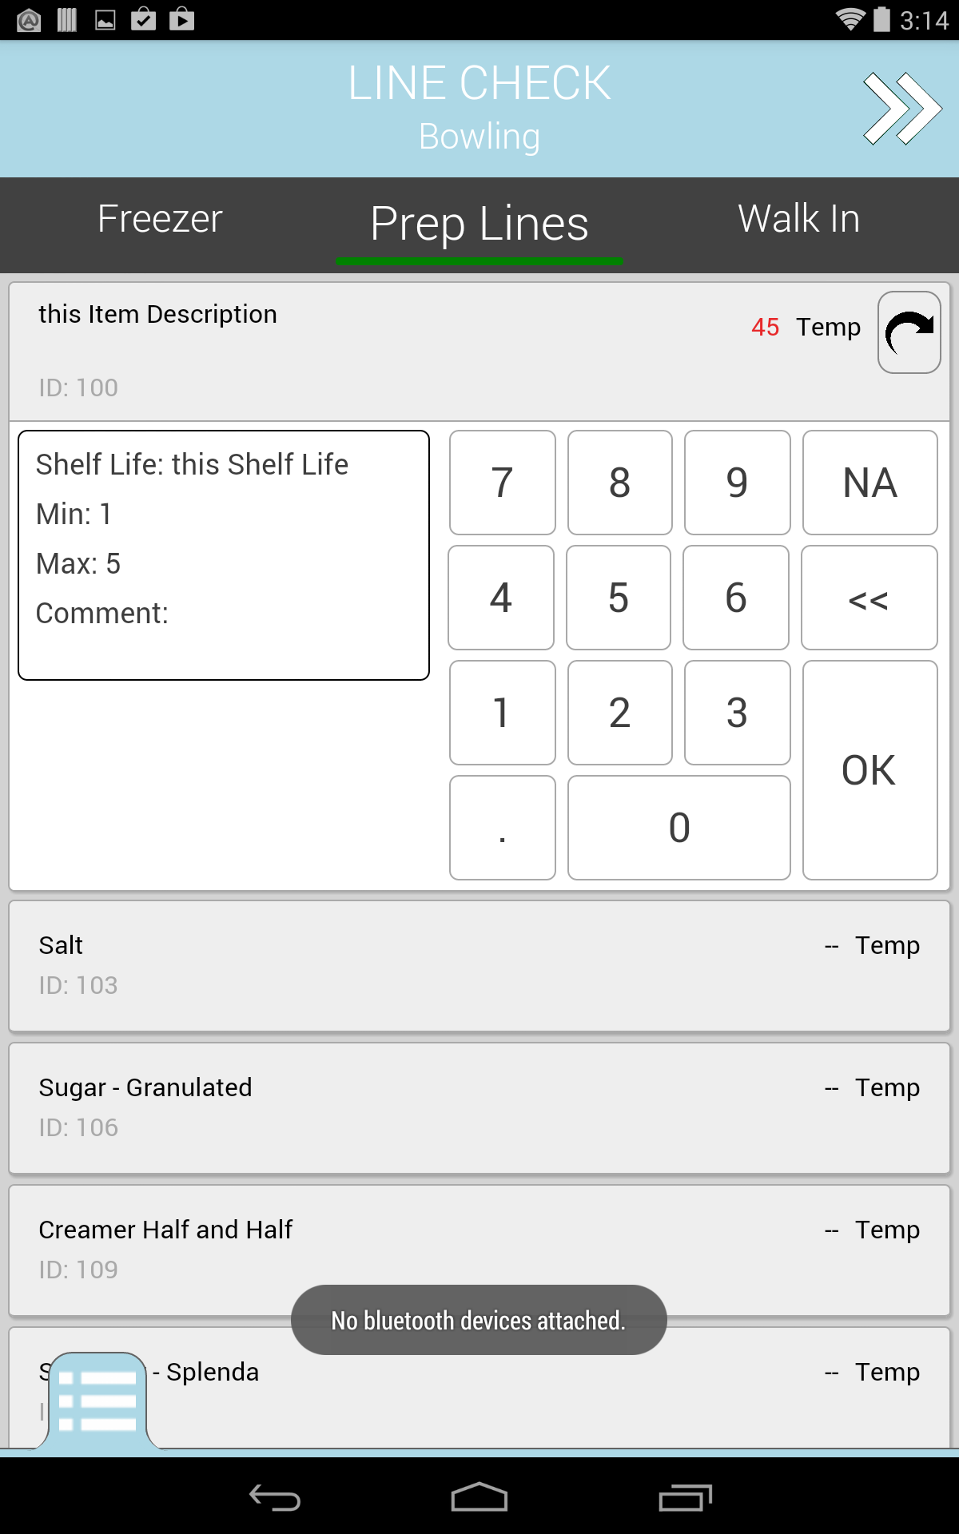
Move locations by swiping over the locations bar.

Slide 8
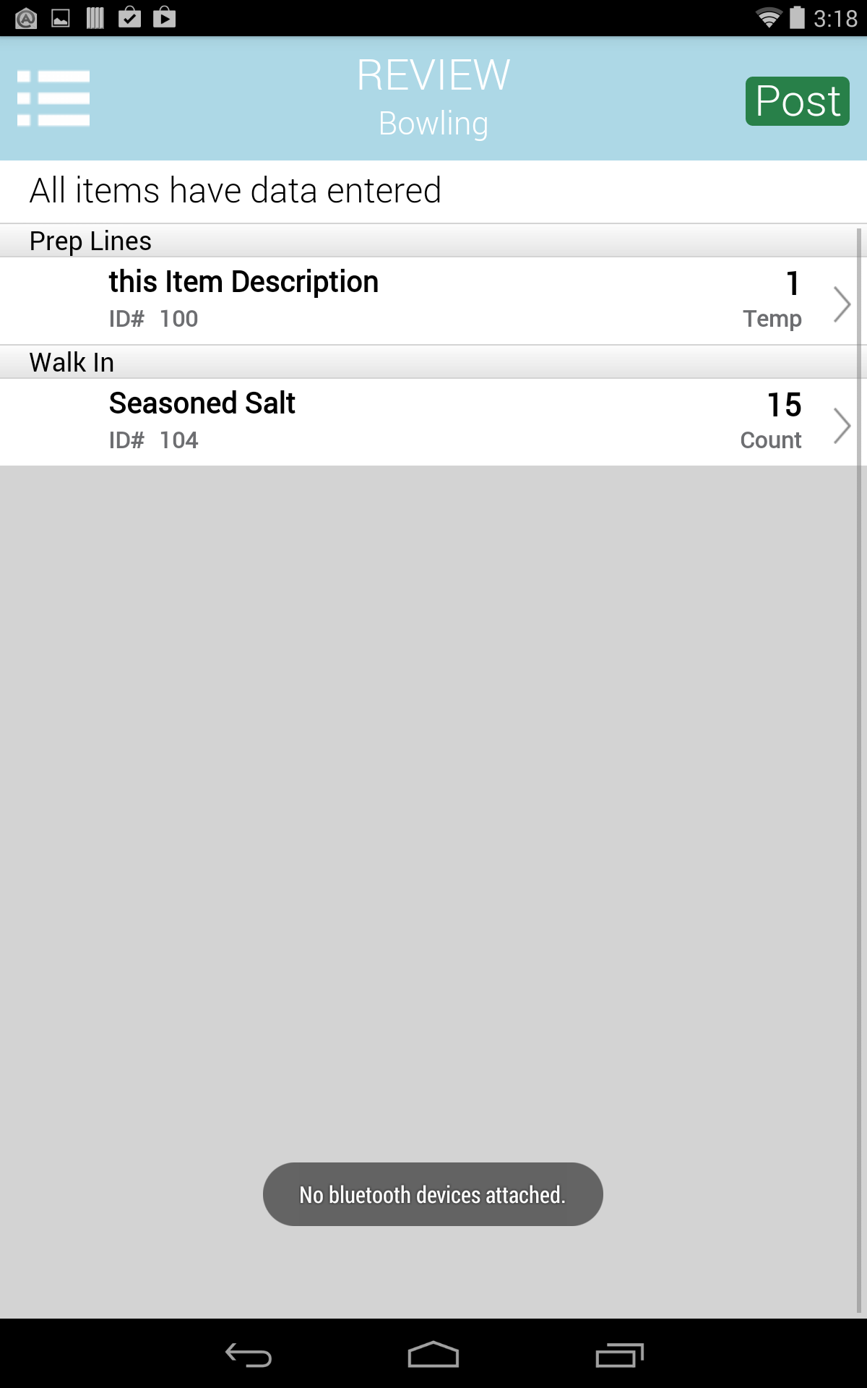
When Line Check is complete Select Post

Slide 9
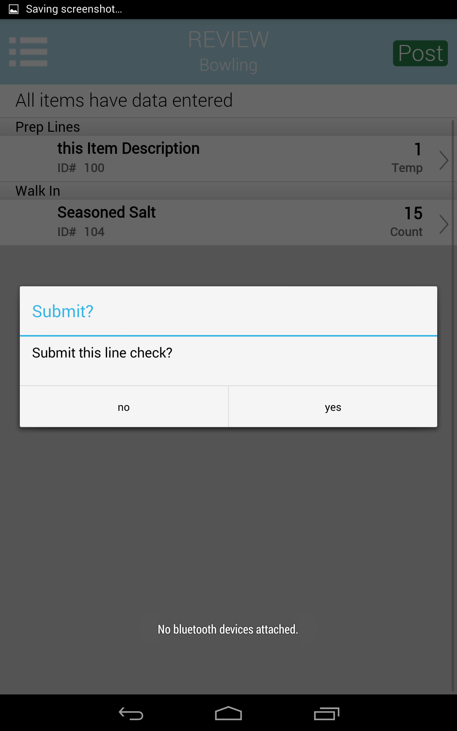

Slide 10
